Slide 1

Flexible In Situ with ParaView
2011 Workshop on Ultrascale Visualization
November 13, 2011
Kenneth Moreland (SNL), Nathan Fabian (SNL), Scott Klasky (ORNL), Berk Geveci (Kitware)
SAND 2011-8579P
Sandia National Laboratories is a multi-program laboratory managed and operated by Sandia Corporation,
a wholly owned subsidiary of Lockheed Martin Corporation, for the U.S. Department of Energy’s National
Nuclear Security Administration under contract DE-AC04-94AL85000.

Slide 2
Collaborators
Sandia National Laboratories
Kenneth Moreland
Nathan Fabian
David Thompson
Ron Oldfield
Los Alamos National Laboratories
James Ahrens
Jonathan Woodring
Oak Ridge National Laboratory
Scott Klasky
Norbert Podhorszki
Argonne National Laboratory
Venkatram Vishwanath
Mark Hereld
Michael E. Papka
Kitware, Inc.
Berk Geveci
Utkarsh Ayachit
Andrew C. Bauer
Pat Marion
Sebastien Jourdain
David DeMarle
University of Colorado at Boulder
Michel Rasquin
Kenneth E. Jansen
Rutgers University
Ciprian Docan
Manish Parashar

Slide 3
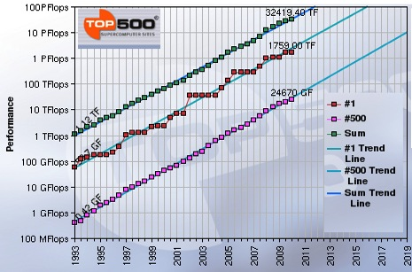
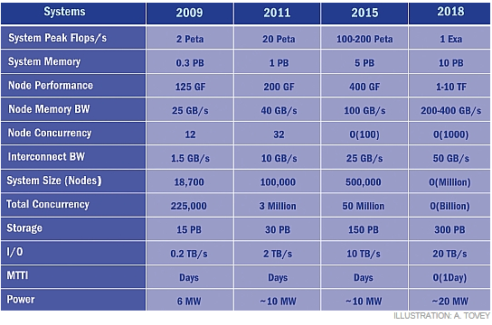
Extreme scale computing
Trends
More FLOPS
More concurrency
Comparatively less storage, I/O bandwidth
ASCI purple (49 TB/140 GB/s) – JaguarPF (300 TB/200 GB/s)
Most people get < 5 GB/sec at scale
From J. Dongarra, “Impact of Architecture and Technology for Extreme Scale on Software and Algorithm Design,” Cross-cutting Technologies for Computing at the Exascale, February 2-5, 2010.
Notes:
Explain why users get < 5GB/s

Slide 4
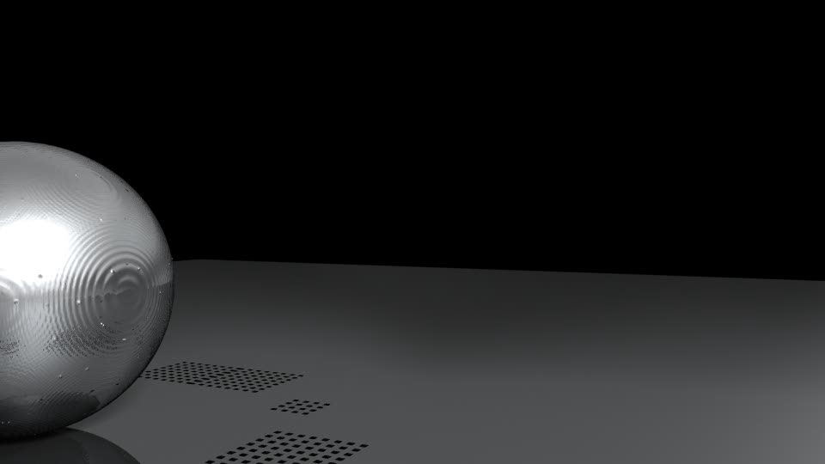
1 mesh per 100 steps
~1% write time
1 image per 1 step
~0.1% write time

Slide 5
Space of Solutions
 | Capability | Coupling | Footprint | Transfer | Interactive
Custom | Low | Tight | Low | None | No
ParaView In Situ, In Core | High | Tight | High | Possible memcpy | No
ParaView In Situ, Multi-Job | High | Tight | Medium | Subset Hi Speed Transfer | Yes
ParaView In Transit | High | Loose | ~5% Extra Nodes | Hi Speed Transfer | Yes
File-based Post Process | High | Loose | None | Slow Disk, Archive Cost | Yes
Notes:
Intention of talk to introduce the broad spectrum of mechanisms of in situ implementations.
Our extended group has encountered numerous simulations and uses that have vastly different requirements.
This table gives an overview of all the solutions I will talk about.
Just showing this to note that each solution has attractors and detractors.
We’ll revisit this at the end of the talk to discuss in more detail.
Note that the solutions are bookended by two solutions that technically fall outside of my topic.
Top is a custom implementation not using ParaView, bottom is ParaView not using in situ.
Shown here because they fill out the important ends of the spectrum of solutions.
Cannot understand the space without them.

Slide 6
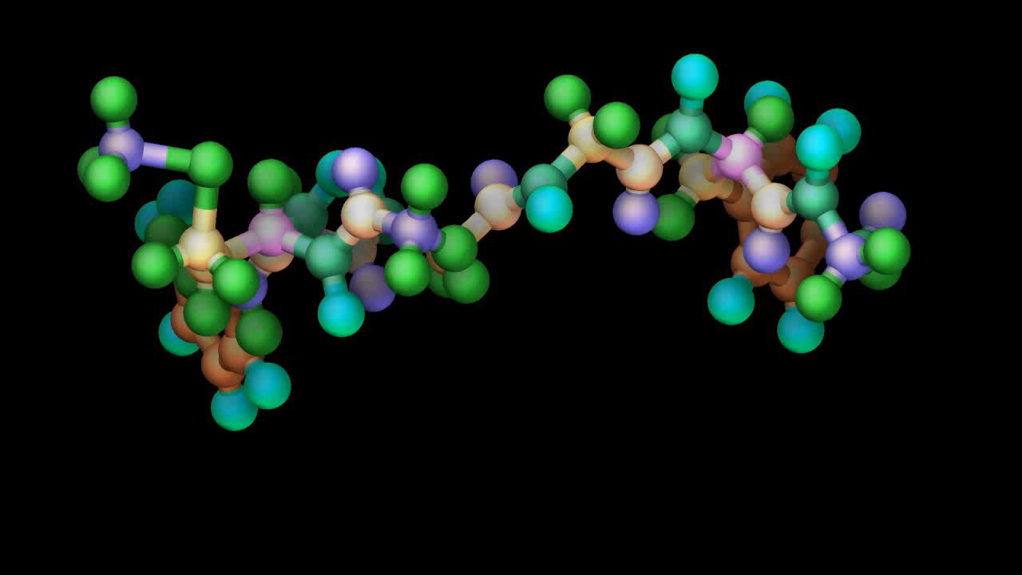
 | Capability | Coupling | Footprint | Transfer | Interactive
Custom | Low | Tight | Low | None | No
Notes:
The most lightweight solution you can implement is a custom implementation of the exact thing needed.
If the requirements are specific and simple, the best solution may be to “hand code” it rather than use a more general solution like ParaView.
This image from a custom rendering routine written by Nathan Fabian for LAMMPS of a peptide molecule.
Does only one simple type of render, but users were thrilled.
Entire code, including rendering and I/O, about 2,500 lines of code.
No dependencies on OpenGL or other vis libraries.
Takeaway: in this case it doesn’t make sense to take the large overhead of 2 million LOC in VTK for one simple routine.
I doubt any general solution can compete in this sense.
If you try to force one on simulation users and developers, you may alienate yourself because you don’t really understand their problem space.
But, if you’re doing more than one specific, simplistic operation, have we got the general solution for you.

Slide 7
 | Capability | Coupling | Footprint | Transfer | Interactive
ParaView In Situ, In Core | High | Tight | High | Possible memcpy | No
Simulation
ParaView Server
function
calls
Adaptor
function
calls
Coprocessing API
Initialize()
AddPipeline(in pipeline)
RequestDataDescription(in time, out fields)
CoProcess(in vtkDataSet)
Finalize()
Notes:
Several years ago, our group set out to leverage our large-scale visualization framework in ParaView in situ.
The result is something we currently call the coprocessing library.
The goals were to make it flexible and simple enough to adapt to many problem domains.
To that end, designed this front end interface: a large-scale visualization library with a 5 function API.
Initialize and finalize. Set up pipeline (hardcoded or scripted). Go.
Simulation keeps event loop control. When convenient, make a function call to do some processing. Returns when done.
By design, the capabilities of the system are high. Get almost 2 decades worth of visualization R&D.
But, requires a tight coupling between systems.
Although we have minimized the amount of code required to interface ParaView to simulation, still requires significant knowledge to get it done.
Biggest task to adapt data representation of simulation to data representation ParaView understands (VTK structures).
May or may not require memory copies. Depends on layout compatibility and tradeoffs between memory and execution.
Another issue is the size of the footprint of ParaView and VTK. Nominally 2-3 million LOC worth of instructions.
Can be dramatically reduced if you know what you want to do a priori (i.e. limit functionality).
Even so, the linking of a library that can take 1 hour to compile can be intimidating in any case. Still actively working on this.
Note that interactivity is not directly supported. This is by design.
Interactivity requires control of an event loop that seriously complicates the integration into a simulation that has its own event loop. Can also complicate establishing batch processing. Wanted simplicity.
There are ways to add interactivity. More on that later.

Slide 8
Simulation
ParaView Coprocessing
Notes:
The intention and upshot is to embed the ParaView facilities in any simulation.

Slide 9
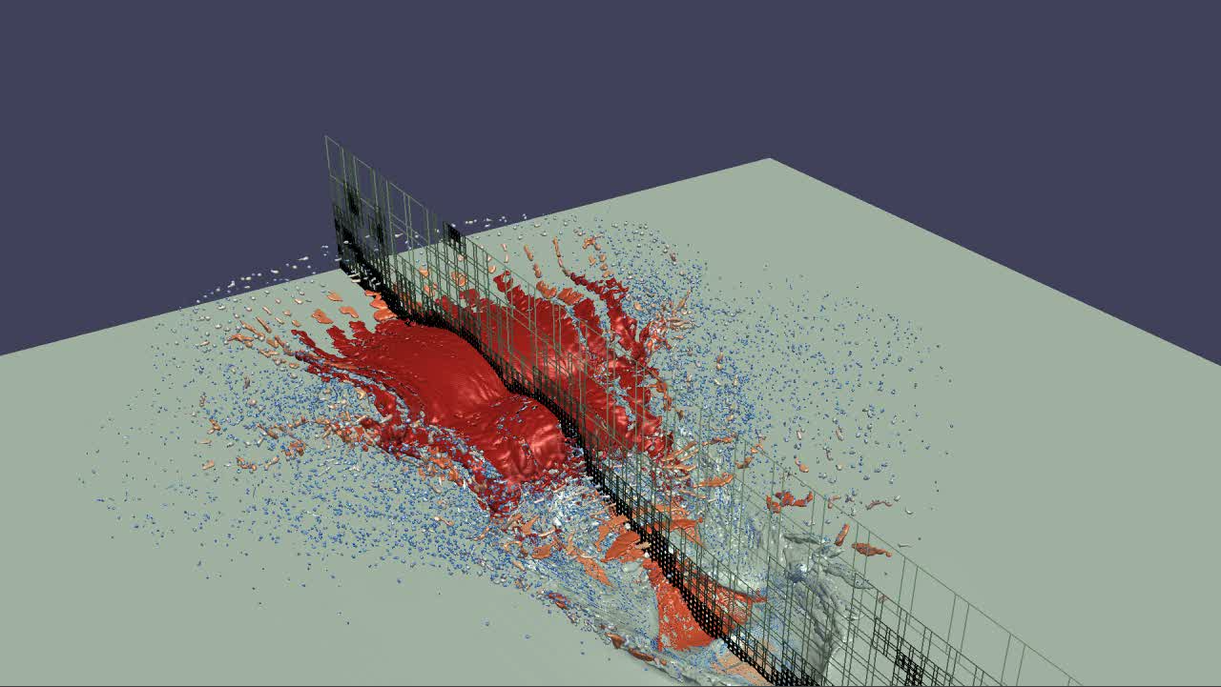
Simulation
ParaView Coprocessing
Output Processed Data
Rendered Images
Notes:
Nominally you will use that to create rendered images.

Slide 10
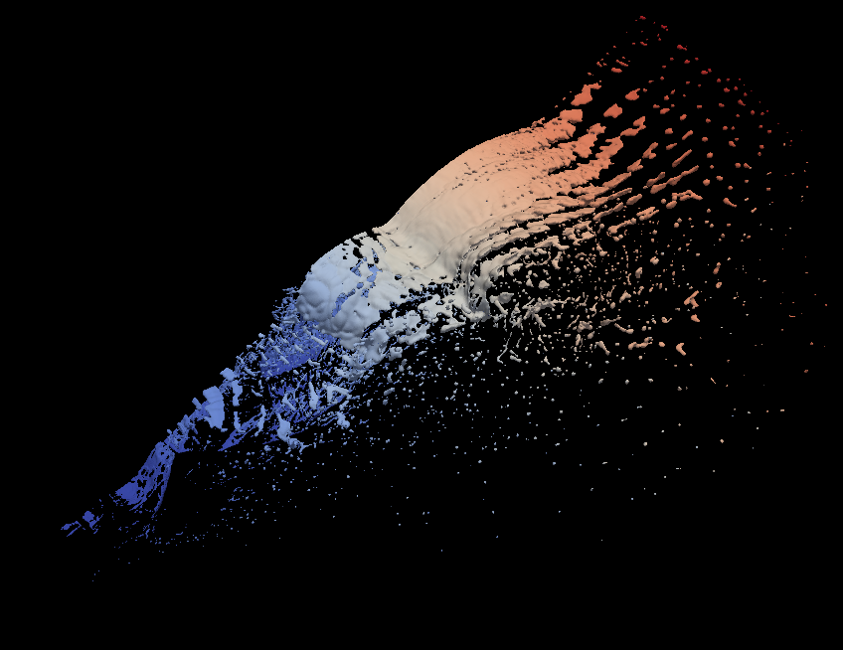
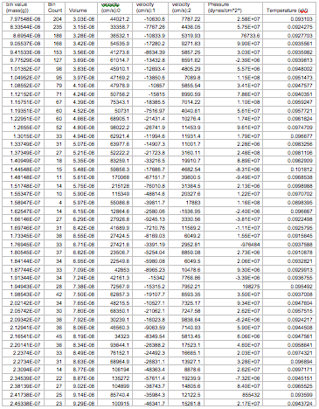
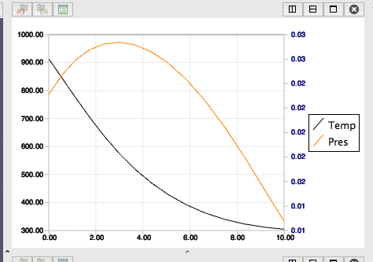
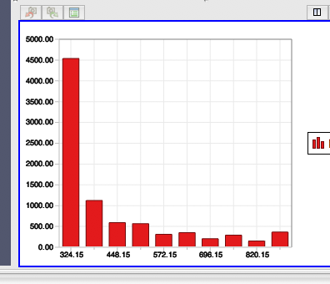
Simulation
ParaView Coprocessing
Output Processed Data
Polygonal Surfaces Field Data
Statistics
Line Series
Rendered Images
Notes:
But of course, ParaView is capable of so much more.
There are a variety of ways to process and analyze data.
Rather than rendering, what we really want is to move some of the analysis to the simulation and extract more information-rich data.

Slide 11
# Create the reader and set the filename.
reader = servermanager.sources.Reader(FileNames=path)
view = servermanager.CreateRenderView()
repr = servermanager.CreateRepresentation(reader, view)
reader.UpdatePipeline()
dataInfo = reader.GetDataInformation()
pDinfo = dataInfo.GetPointDataInformation()
arrayInfo = pDInfo.GetArrayInformation("displacement9")
if arrayInfo:
# get the range for the magnitude of displacement9
range = arrayInfo.GetComponentRange(-1)
lut = servermanager.rendering.PVLookupTable()
lut.RGBPoints = [range[0], 0.0, 0.0, 1.0,
range[1], 1.0, 0.0, 0.0]
lut.VectorMode = "Magnitude"
repr.LookupTable = lut
repr.ColorArrayName = "displacement9"
repr.ColorAttributeType = "POINT_DATA"
Simulation
Augmented script in input deck.
ParaView Coprocessing
Output Processed Data
Polygonal Surfaces Field Data
Statistics
Line Series
Rendered Images
Notes:
There are a variety of ways in which to specify what processing should be done.
The most flexible way to specify is to employ ParaView’s scripting capabilities.

Slide 12
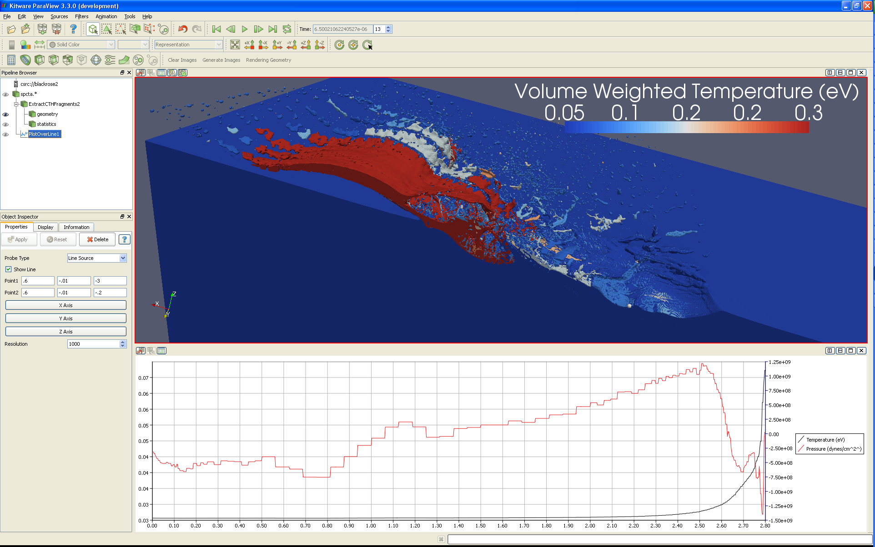
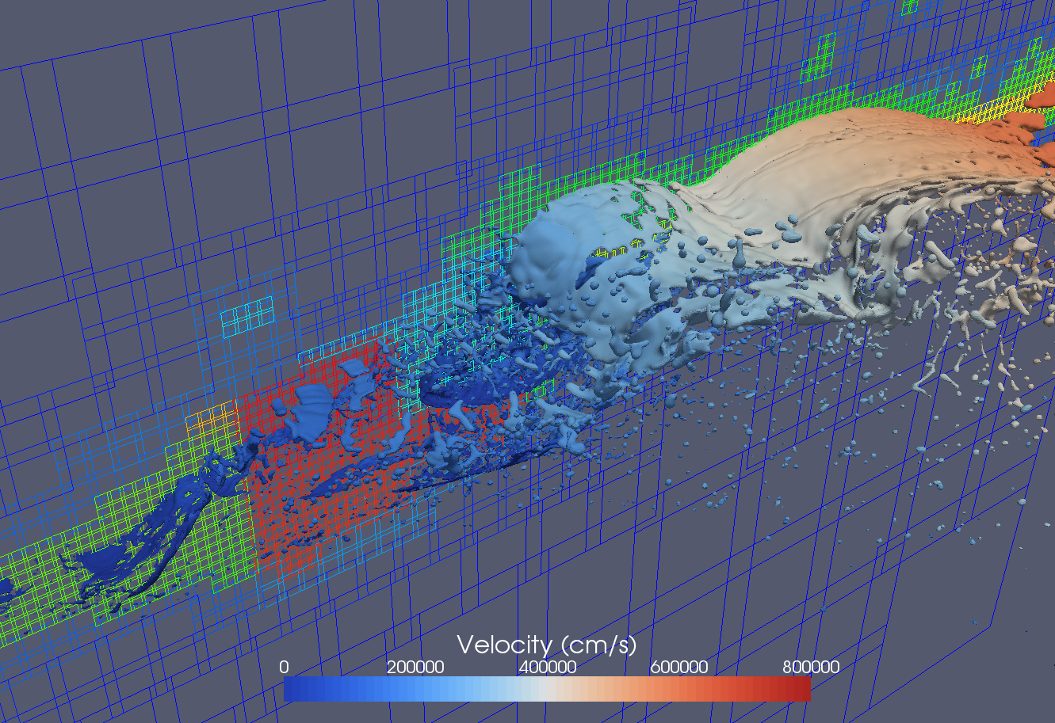
# Create the reader and set the filename.
reader = servermanager.sources.Reader(FileNames=path)
view = servermanager.CreateRenderView()
repr = servermanager.CreateRepresentation(reader, view)
reader.UpdatePipeline()
dataInfo = reader.GetDataInformation()
pDinfo = dataInfo.GetPointDataInformation()
arrayInfo = pDInfo.GetArrayInformation("displacement9")
if arrayInfo:
# get the range for the magnitude of displacement9
range = arrayInfo.GetComponentRange(-1)
lut = servermanager.rendering.PVLookupTable()
lut.RGBPoints = [range[0], 0.0, 0.0, 1.0,
range[1], 1.0, 0.0, 0.0]
lut.VectorMode = "Magnitude"
repr.LookupTable = lut
repr.ColorArrayName = "displacement9"
repr.ColorAttributeType = "POINT_DATA"
Simulation
Augmented script in input deck.
Script Export
ParaView Coprocessing
Output Processed Data
Polygonal Surfaces Field Data
Statistics
Line Series
Rendered Images
Notes:
And the easiest way to generate these scripts is to use the ParaView application itself.
With this we thus close the loop on the analysis.
With a proxy geometry, establish a visualization and export a script.
Use the script in a running simulation to generate extracted information.
Perform analysis on the extracted information, possibly with ParaView again.
Use the results to establish new visualizations for the next simulation.

Slide 13
Interactive Visualization
In-situ Library, Coupled with codes
Intrepid
(ANL)
Cielo
(LANL/SNL)
Red Sky
(SNL)
Notes:
One of the challenges of providing an in situ visualization library is that you are now obligated to scale to as many processes as the target simulation.
This has redefined what we mean by “large scale.”
5 years ago we were using a few hundred cores for our largest visualizations.
In the short time since then we’ve been scaling up our system to true petascale analysis with over 100,000 cores.
The ParaView framework holds up remarkably well with this 1000-fold increase.
The performance of individual filters of course varies, but most have little if any communication and perform well.

Slide 14
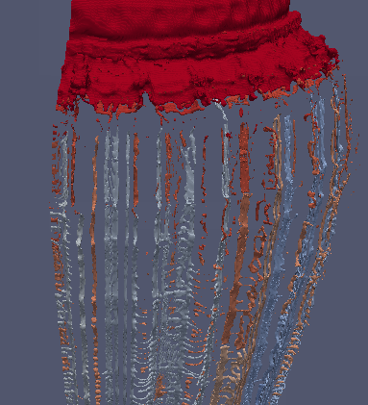
Notes:
Integrating visualization with simulation and scaling to large jobs can have subtle consequences.
Consider this task of isosurface and fragment extraction in AMR.
It builds a dual grid to create manifold surfaces across regions of different refinement.
Needs to know where adjacent regions are located.
When loading data off disk, finding adjacency across processes is no problem: repartition data anyway.
When in situ on large numbers of cores, extremely inefficient.
Simulation already has this information, we can skip this step if we could just retrieve it.
There is no mechanism to do this: it’s never been important for disk-based post processing
So the problem requires a deeper level of coupling to pass this important metadata from simulation to visualization.
Observation: despite our work to minimize the amount of work to couple ParaView with simulation, sometimes these coupling creep up on you.

Slide 15
 | Capability | Coupling | Footprint | Transfer | Interactive
ParaView In Situ, Multi-Job | High | Tight | Medium | Subset Hi Speed Transfer | Yes
Full scale
Simulation
w/ In situ
Smaller scale
Covisualization
Interactive Client
Notes:
Rather than work to tighten the coupling, you can also work to loosen the coupling.
In this case, we still interface the ParaView coprocessing library with the simulation, but we limit the operations we do in that job
Rather than do all in situ processing, we do some limited operations that condition the data to be sent to a ParaView server elsewhere.
Several advantages of this approach:
Can take advantage both of highly scalable algorithms and of less scalable algorithms that run better on “fat memory” nodes.
Reduce the footprint of the code actually in the simulation job.
Because you have a second ParaView server job with its own event loop, you now have the option of running it interactively.

Slide 16
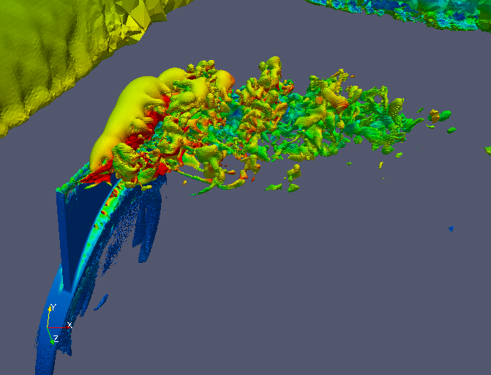
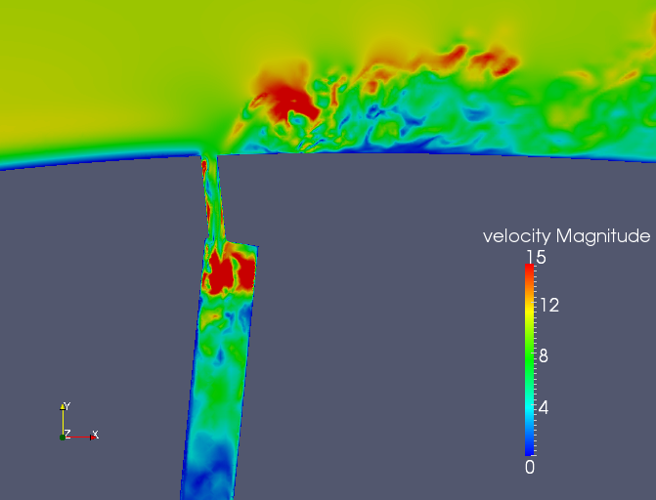
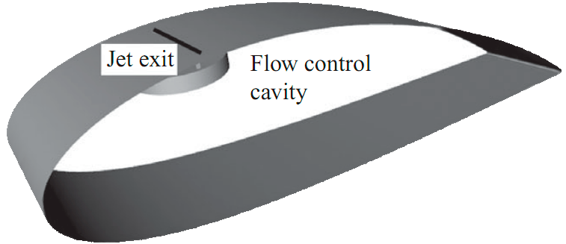
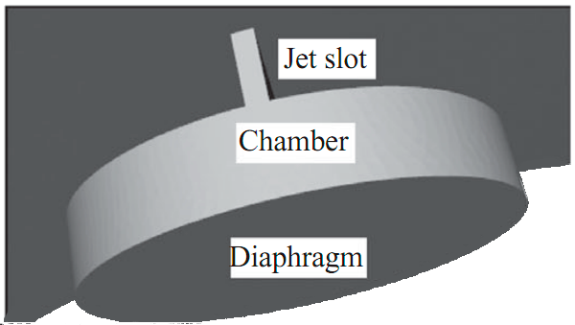
Notes:
CFD Simulation with PHASTA
Flow over wing with synthetic jet
3.3 Billion tetrahedra
Pedantic details:
Active flow control applied to a NACA wing profile.
Finite wing
Angle of attack alpha=9 degrees
Re = 100,000
Synthetic jet with blowing coefficient C_b = 1.2 and f_act = 1,750 Hz

Slide 17
 | Capability | Coupling | Footprint | Transfer | Interactive
ParaView In Transit | High | Loose | ~5% Extra Nodes | Hi Speed Transfer | Yes
Computation Nodes
Simulation
Simulation Results
Vis
Interactive Vis Controls
Staging
Nodes
Vis
Client
Visualization Results
Notes:
We can take this idea of loose coupling even farther: perform in transit (or staged) visualization.
Rather than couple our code directly with simulation, we use a third-party I/O library to transfer data.
The basic idea is as follows:

Slide 18
 | Capability | Coupling | Footprint | Transfer | Interactive
ParaView In Transit | High | Loose | ~5% Extra Nodes | Hi Speed Transfer | Yes
Computation Nodes
Simulation
Simulation Results
Vis
Interactive Vis Controls
Staging
Nodes
Vis
Client
Visualization Results
Notes:
The simulation runs on the lion’s share of computation nodes.
Of course, simulation applications are just as concerned with file I/O costs as visualization applications.
Writes tend to be “bursty” when saving out large chunks of data for checkpoints or results.

Slide 19
 | Capability | Coupling | Footprint | Transfer | Interactive
ParaView In Transit | High | Loose | ~5% Extra Nodes | Hi Speed Transfer | Yes
Computation Nodes
Simulation
Simulation Results
Vis
Interactive Vis Controls
Staging
Nodes
Vis
Client
Visualization Results
Notes:
Rather than stall the simulation, a frequently employed trick is to use staging nodes.
Instead of writing directly to disk, the simulation transfers data to the smaller staging job.
The staging nodes buffer and write the data while the simulation continues to the next iteration.
Often the staging nodes are allocated on special I/O nodes through which data has to pass anyway.
This is typically handled via an I/O library. To the simulation it looks like a synchronous write.
The processors in the staging nodes are pretty much idle the whole time.
Good opportunity to do some post-processing.
So… why not run your visualization algorithm on the staging nodes you have allocated anyway?

Slide 20
 | Capability | Coupling | Footprint | Transfer | Interactive
ParaView In Transit | High | Loose | ~5% Extra Nodes | Hi Speed Transfer | Yes
Computation Nodes
Simulation
Simulation Results
Vis
Interactive Vis Controls
Staging
Nodes
Vis
Client
Visualization Results
Notes:
You could run a batch visualization and output the results of the visualization to disk.
Those results are generally significantly smaller than the original data.

Slide 21
 | Capability | Coupling | Footprint | Transfer | Interactive
ParaView In Transit | High | Loose | ~5% Extra Nodes | Hi Speed Transfer | Yes
Computation Nodes
Simulation
Simulation Results
Vis
Interactive Vis Controls
Staging
Nodes
Vis
Client
Visualization Results
Notes:
Or we could interactively connect to the staging nodes and perform visualization from a client.
Or of course, you could do both at the same time.
Several advantages:
Those I/O guys know what they’re doing.
From both simulation and visualization perspective, I/O not much different than file access. Easer to implement and support.
The I/O library has a much smaller footprint for the simulation.
Of course, you need to schedule another job on another set of nodes

Slide 22
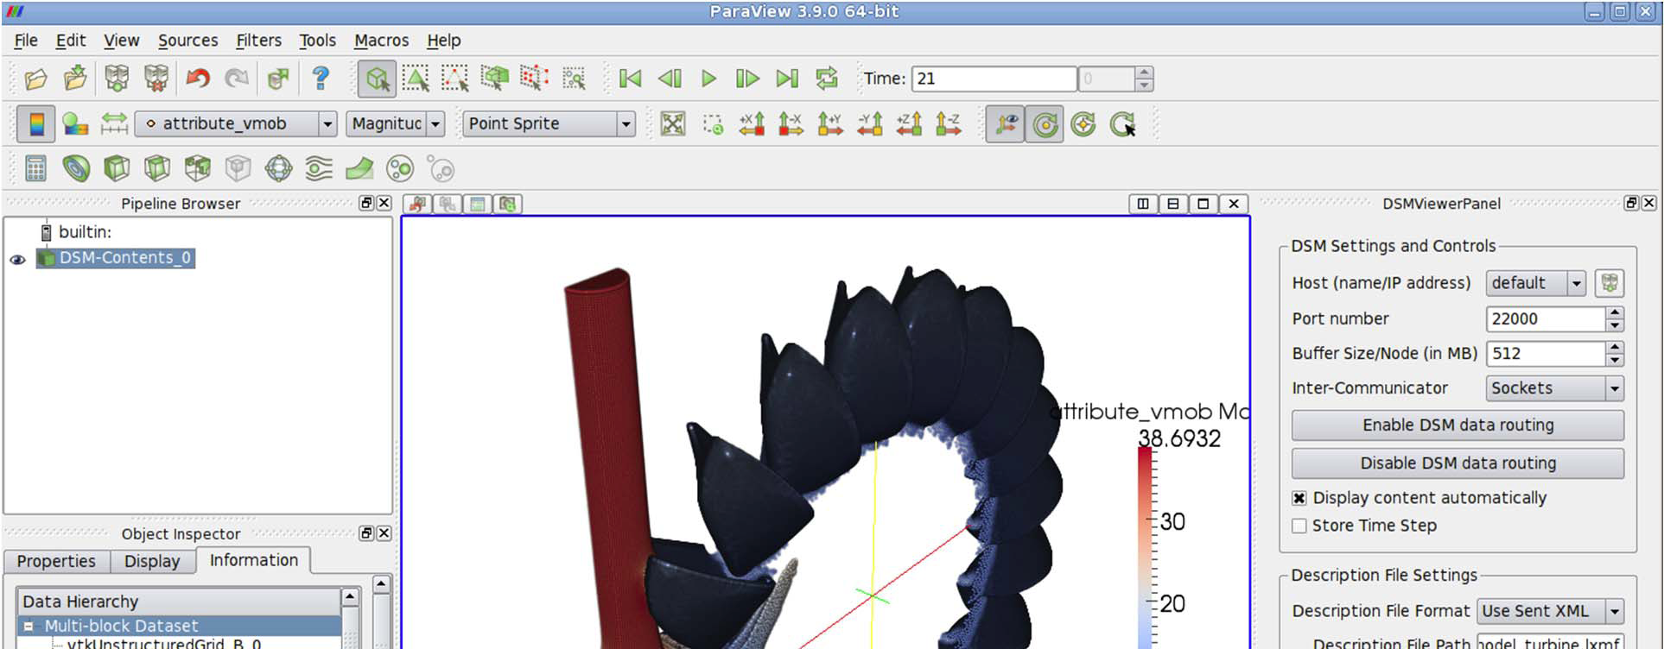
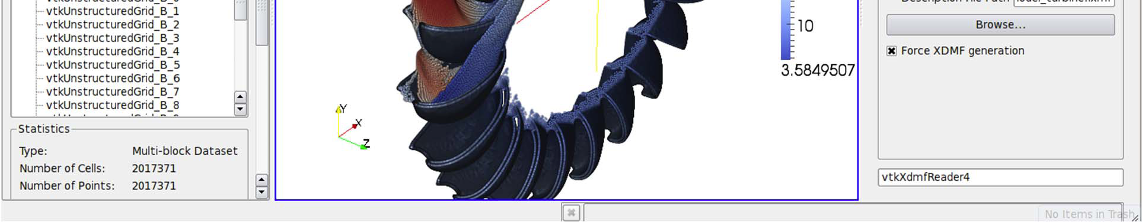
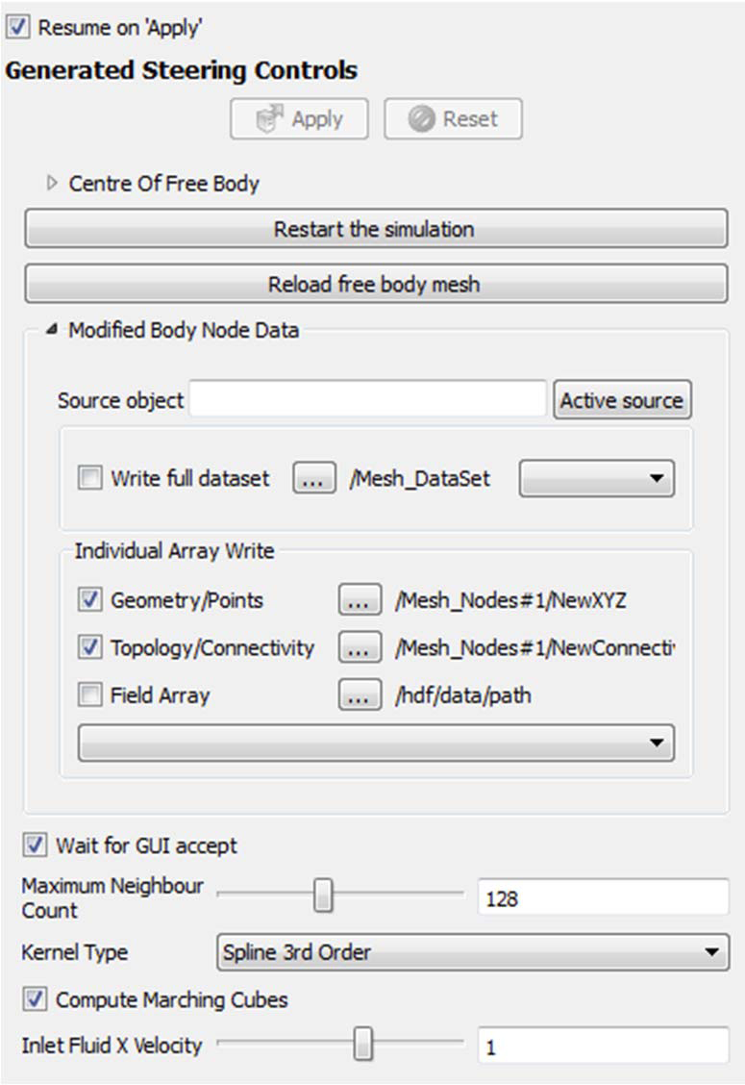
John Biddiscombe’s stuff
<DataExportProperty name="ModifiedBodyNodes"
command="SetSteeringArray"
label="Modified Body Node Data">
<DataExportDomain name="data_export"
full_path="/Mesh_DataSet"
geometry_path="/Mesh_Nodes#1/NewXYZ"
topology_path="/Mesh_Nodes#1/NewCo..."
command_property="ReloadFreeBodyMesh" />
</DataExportProperty>
Biddiscombe, et al, “Parallel Computational Steering and Analysis for HPC Applications using a ParaView Interface and the HDF5 DSM Virtual File Driver.”
Notes:
There are numerous examples of this in transit analysis. Here is an example that comes from the Swiss National Supercomputing Centre.
In this example the simulation writes out to the HDF5 library with a virtual file extension.
Instead of to disk, the data gets sent to a running ParaView server instance.
Can provide batch computing or interactive visualization.
Through extensions, can also provide feedback for simulation steering.
A ParaView plugin can dynamically read XML to customize GUI and controls for running simulation.

Slide 23
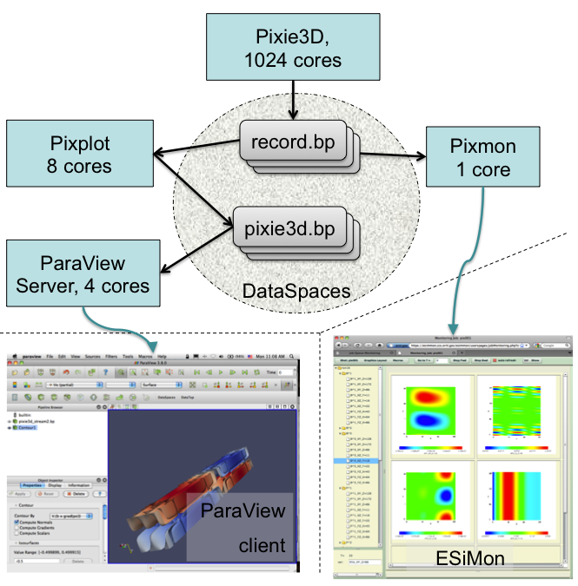
Notes:
Another great thing about in transit: not limited to simple simulation/visualization interface.
Can create a federated environment of loosely-coupled tools working together.
Provided proof of concept last year with a simulation working with two post-processing tools and ParaView server.
EXPLAIN WHAT IS GOING ON.
None of these tools were directly away of each other.
Hope to expand and harden this capability in the near future.

Slide 24
Space of Solutions
 | Capability | Coupling | Footprint | Transfer | Interactive
Custom | Low | Tight | Low | None | No
ParaView In Situ, In Core | High | Tight | High | Possible memcpy | No
ParaView In Situ, Multi-Job | High | Tight | Medium | Subset Hi Speed Transfer | Yes
ParaView In Transit | High | Loose | ~5% Extra Nodes | Hi Speed Transfer | Yes
File-based Post Process | High | Loose | None | Slow Disk, Archive Cost | Yes
Notes:
I conclude by once again looking at the space of in situ solutions.
We note that none of these is a silver bullet – even accounting for the inherent limitations with in situ.
The choice of your solution depends heavily on the needs of the application. The one you choose depends on what you can tolerate (and what is easy for now).
There will likely be gravity toward some subset of these solutions, but for the time being we must do all and do them all well.

Slide 25
Shameless Promotion of Other Presentations
Sun | 1:30 | TCC 205 | ParaView In Situ Tutorial
Mon | 2:30 | Hyatt/Princessa II | PDAC: Examples of In Transit Visualization
Tue | 10:00 | ASC Booth | In Situ Visualization and Analysis
Tue | 11-1 | ASC Booth | ParaView Demonstrations
Tue | 5:15 | Poster Reception | Co-visualization of full data and in situ data extracts from unstructured grid CFD at 160k cores
Tue | 5:30 | TCC LL1 | BoF: Next Generation I/O and visualization requirements for in situ processing
Thu | 10-12 | ASC Booth | ParaView Demonstrations
Thu | 10:30 | ASC Booth | ASC Tri-Lab Visualization on the Cielo Platform
Questions?
Notes:
Highlighted in blue activities you are probably most interested in.

